Slide 1

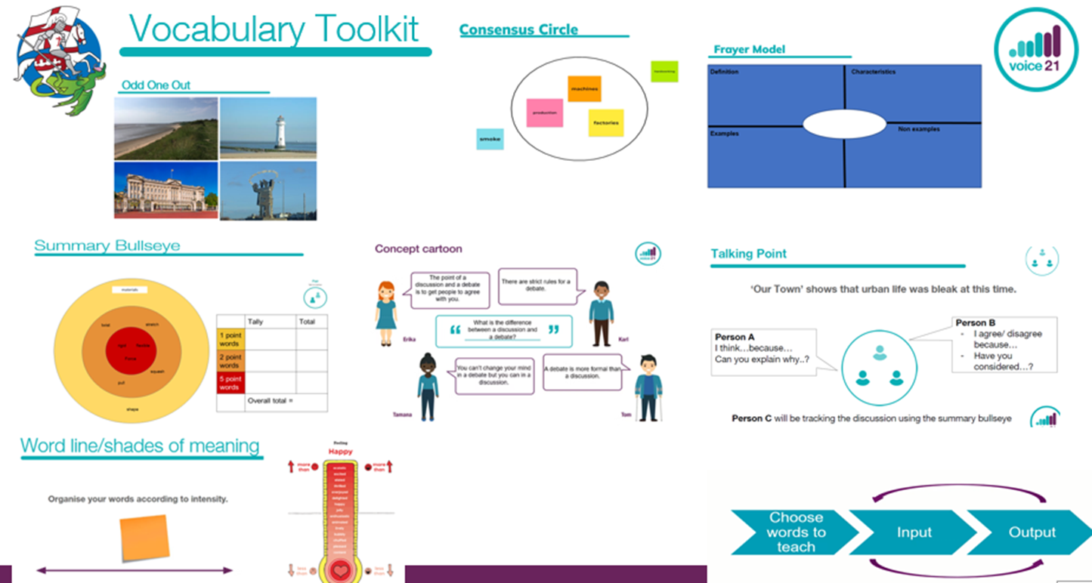
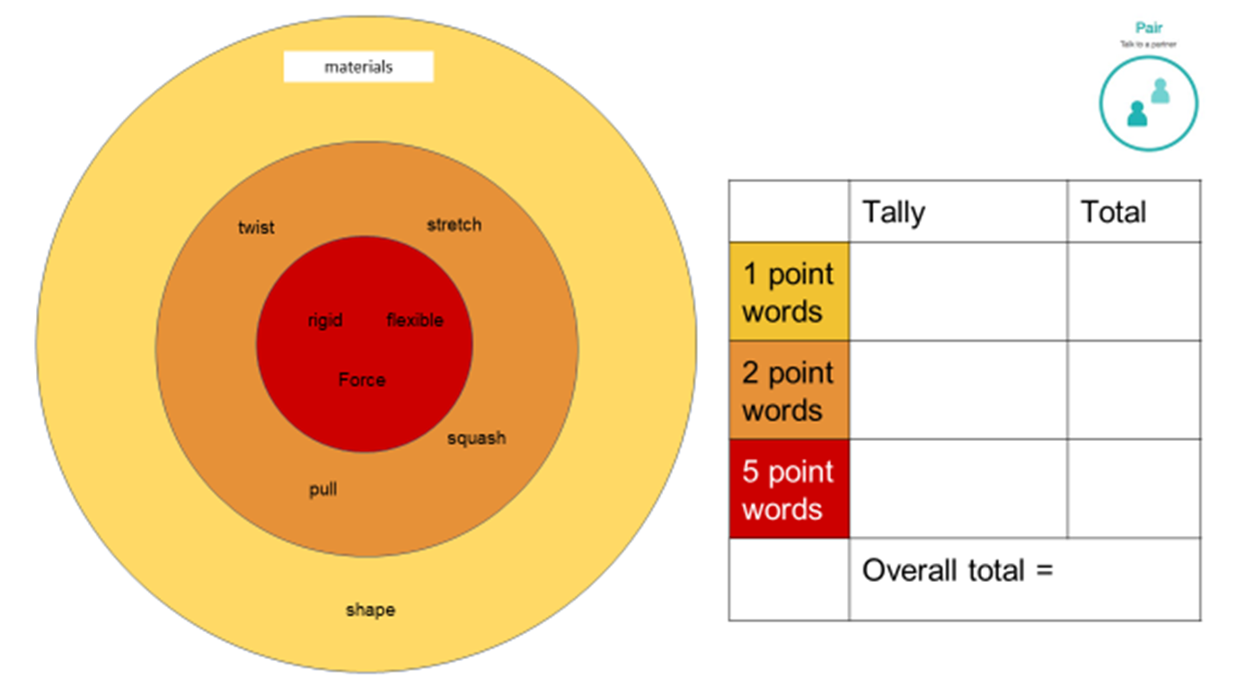

St George’s Approach to Teaching Vocabulary
1. Identify key vocabulary on unit plans
  Previously taught vocab (tier 1) – yellow
  Essential vocabulary (tier 2) – orange
  Desirable vocabulary (tier 3) - red
2. Use the vocabulary toolkit
Teach the vocabulary throughout the unit of work.
Add word cards to the bullseye on the working wall and practise using the words in context.
Use AfL strategies to check that children understand the meanings of the new vocabulary.
3. Bullseye Summary
Use the bullseye to discuss learning.
Teachers use this an opportunity to assess learning within the unit of work.
Follow up written opportunities can be developed from these discussions.

